Slide 1


Halyna Zhdan
27.07.2024

Slide 2

Outline
Executive Summary
Introduction
Methodology
Results
Conclusion
Appendix

Slide 3
Executive Summary
Summary of methodologies
Data understanding
Data collection with Web Scraping
Data Wrangling
Using SQL to analyze data
Exploring data with visuals and building analytics with Folium
Building ML model
Summary of all results
Data Analysis results
Data Visualizations results
Machine Learning predictive results

Slide 4
Introduction
Project background and context
SpaceX advertises Falcon 9 rocket launches on its website with a cost of 62 million dollars; other providers cost upward of 165 million dollars each, much of the savings is because SpaceX can reuse the first stage. Therefore, if we can determine if the first stage will land, we can determine the cost of a launch. This information can be used if an alternate company wants to bid against SpaceX for a rocket launch. We need to collect a data and build a ML model that predicts if SpaceX can reuse the first stage and if launch will land successfully.
Problems you want to find answers
What indicators must exist to land successfully
How to eliminate known issues

Slide 5

Section 1

Slide 6
n this lab we will mainly convert those outcomes into Training Labels with 1 means the booster successfully landed 0 means it was unsuccessful.
Methodology
Executive Summary
Data collection methodology:
Data was collected using web scraping and SpaceX REST API
Perform data wrangling
We encoded data to 0 and 1 , 0 landing was unsuccessful and 1 successful
Perform exploratory data analysis (EDA) using visualization and SQL
Perform interactive visual analytics using Folium and Plotly Dash
Perform predictive analysis using classification models
How to build, tune, evaluate classification models

Slide 7
Data Collection
We used below techniques to collect and clean data
Data was collected using SpaceX REST API with get request
Then we used json() and .json_normalize() to convert to dataframe
Once in df data was cleaned
Also we used beautifulsoap package for web scraping to get data from wikipedia

Slide 8
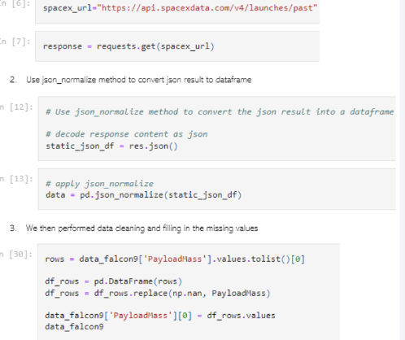
Data Collection – SpaceX API
Present your data collection with SpaceX REST calls using key phrases and flowcharts
Add the GitHub URL of the completed SpaceX API calls notebook IBM-SpaceX/01-jupyter-labs-spacex-data-collection-api.ipynb at main · halynazhdan/IBM-SpaceX (github.com) as an external reference and peer-review purpose
Place your flowchart of SpaceX API calls here

Slide 9
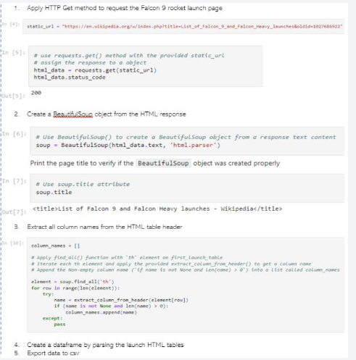
Data Collection - Scraping
Present your web scraping process using key phrases and flowcharts
IBM-SpaceX/02-jupyter-labs-webscraping.ipynb at main · halynazhdan/IBM-SpaceX (github.com)
Place your flowchart of web scraping here

Slide 10

Data Wrangling
Describe how data were processed
We did exploratory data analysis and defined training labels, encoded data to 0 and 1 , 0 landing was unsuccessful and 1 successful, after exported to csv
IBM-SpaceX/03-labs-jupyter-spacex-Data wrangling (1).ipynb at main · halynazhdan/IBM-SpaceX (github.com)

Slide 11
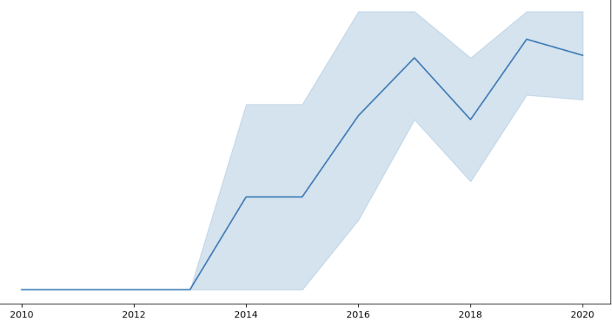
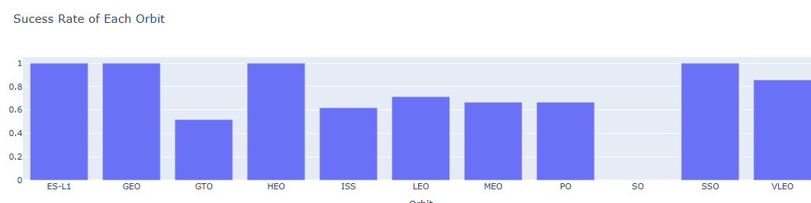
EDA with Data Visualization
Summarize what charts were plotted and why you used those charts
We built dashboards between flight # and launch site, success rate, flight number and orbit and success trend by year
IBM-SpaceX/04-edadataviz.ipynb at main · halynazhdan/IBM-SpaceX (github.com)

Slide 12
EDA with SQL
Below SQL queries have been built and executed:
Unique Sites names in the space mission
We calculated the total payload mass carries by boosters
We calculated the average payload mass carried by booster
The total of success and failure outcomes
We calculated the failed landing outcome , booster version and site name
IBM-SpaceX/05-jupyter-labs-eda-sql-coursera_sqllite (1).ipynb at main · halynazhdan/IBM-SpaceX (github.com)

Slide 13
Build an Interactive Map with Folium
We added objects :markers, circles, lines to mark launches of success or failure on the folium map
0 was assigned for failure and 1 for success, use color marker to check which site was successful and which failed
IBM-SpaceX/06-lab_jupyter_launch_site_location.ipynb at main · halynazhdan/IBM-SpaceX (github.com)

Slide 14
Build a Dashboard with Plotly Dash
Interactive dashboard was created using Plotly
We built pie charts total values by sites
Plot scatter with Outcome, Payload for booster's version
IBM-SpaceX/07-spacex_dash_app_copy (1).py at main · halynazhdan/IBM-SpaceX (github.com)

Slide 15
Predictive Analysis (Classification)
Data was loaded with numpy and pandas, transformed
After transformed it was split into test and train
Used GridSearchCV to build ML
Applied accuracy for the model, improved the model and developed the classification ML with the best performance
IBM-SpaceX/08-ML-Predict.ipynb at main · halynazhdan/IBM-SpaceX (github.com)

Slide 16
Results
Exploratory data analysis results
Interactive analytics demo in screenshots
Predictive analysis results

Slide 17

Section 2

Slide 18
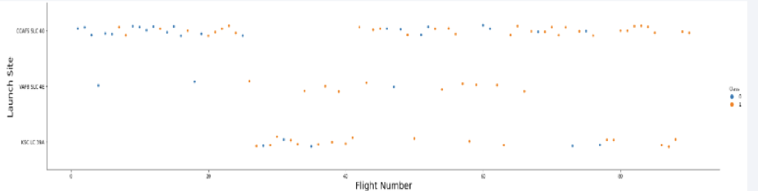
Flight Number vs. Launch Site
As per below plot flight amount is correlated to success rate, larger flight-> more success rate

Slide 19
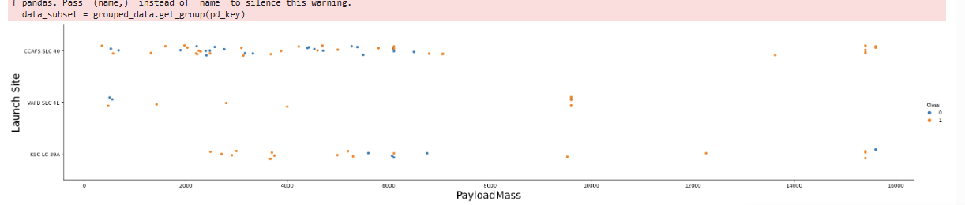
Payload vs. Launch Site
Greater payload the higher success rate
Show the screenshot of the scatter plot with explanations

Slide 20
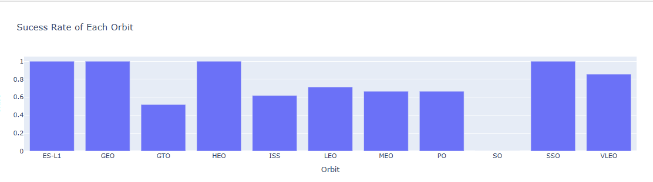
Success Rate vs. Orbit Type
ES-L1,HEO,GEO and SSO having the greatest success rate
Show the screenshot of the scatter plot with explanations

Slide 21
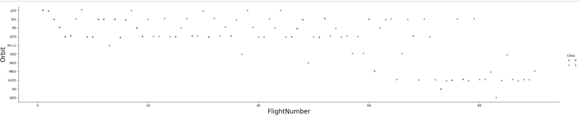
Flight Number vs. Orbit Type
If Orbit=LEO, success is related to # of flights.
If Orbit=GTO, no correlation

Slide 22
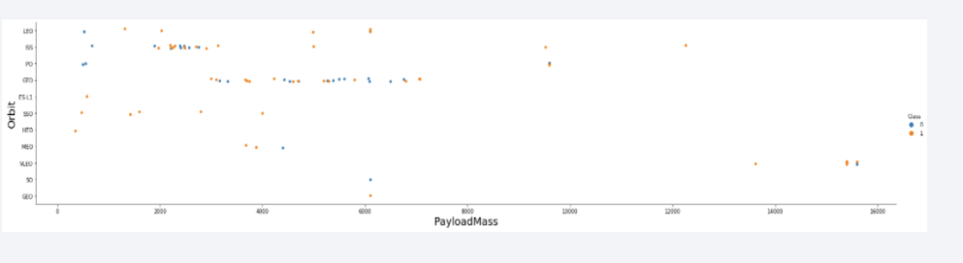
Payload vs. Orbit Type
Orbit=PO,LEO,IIS having more success

Slide 23
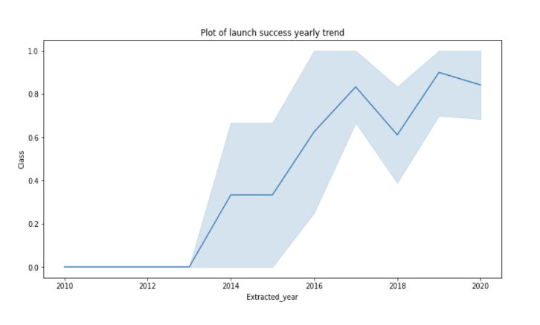
Launch Success Yearly Trend
Starting from 2013 success goes up

Slide 24
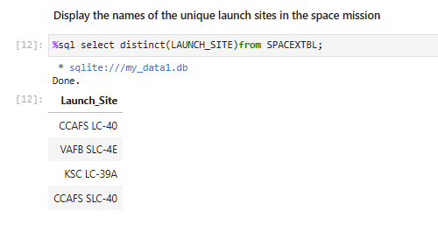
All Launch Site Names
Used distinct

Slide 25
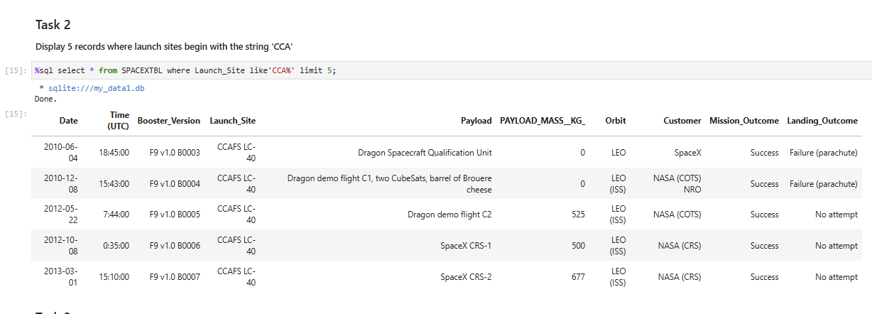
Launch Site Names Begin with 'CCA'
We used below query

Slide 26
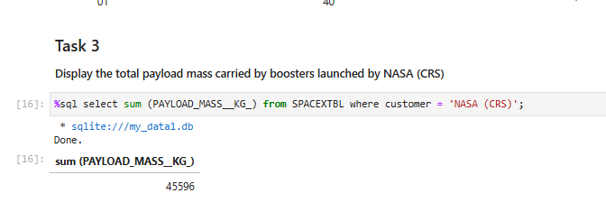
Total Payload Mass
We used below query

Slide 27
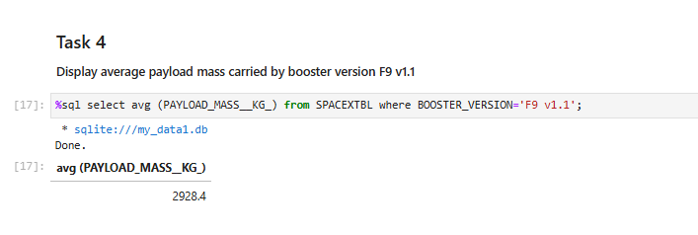
Average Payload Mass by F9 v1.1
We used below query:

Slide 28
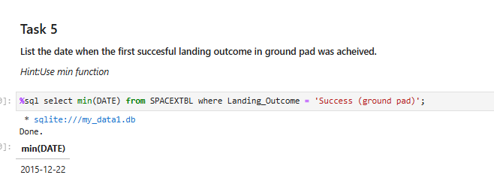
First Successful Ground Landing Date
We used below query:

Slide 29
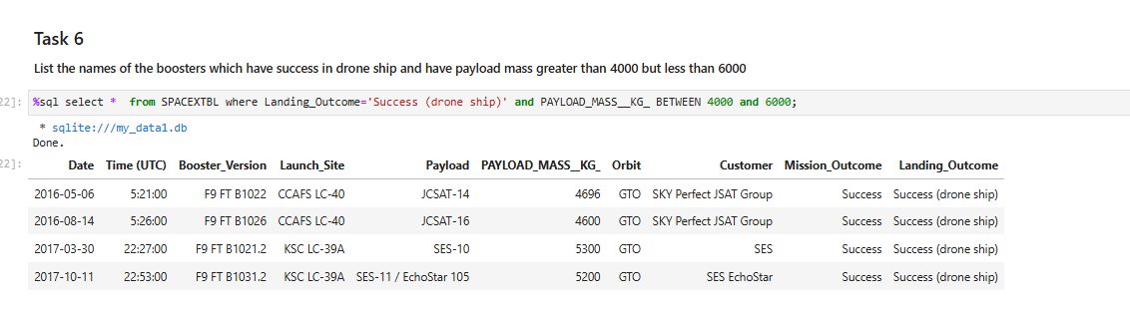
Successful Drone Ship Landing with Payload between 4000 and 6000
We used below query

Slide 30
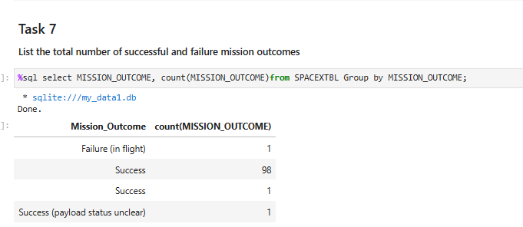
Total Number of Successful and Failure Mission Outcomes
We used query below

Slide 31
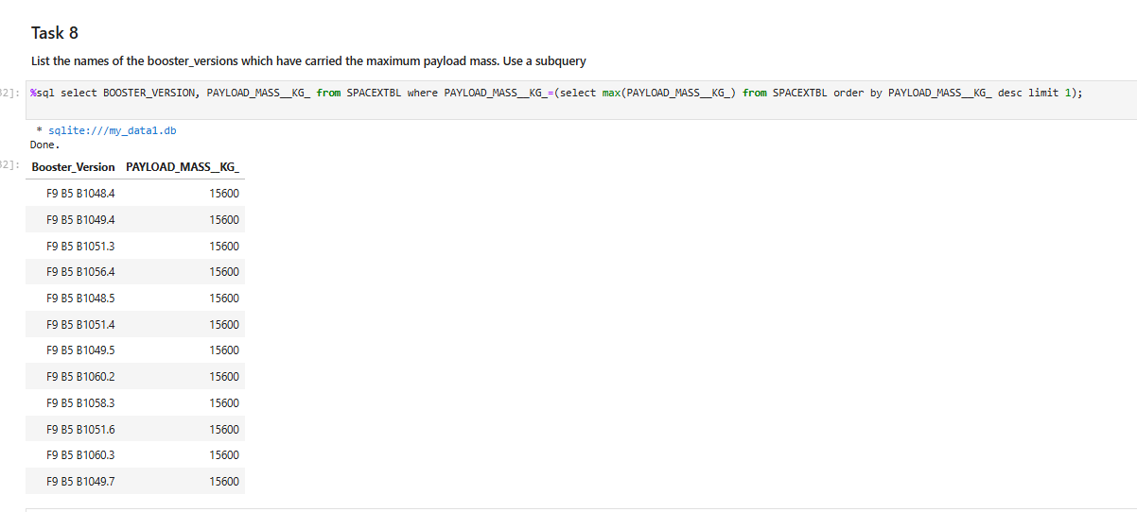
Boosters Carried Maximum Payload
We used query below

Slide 32
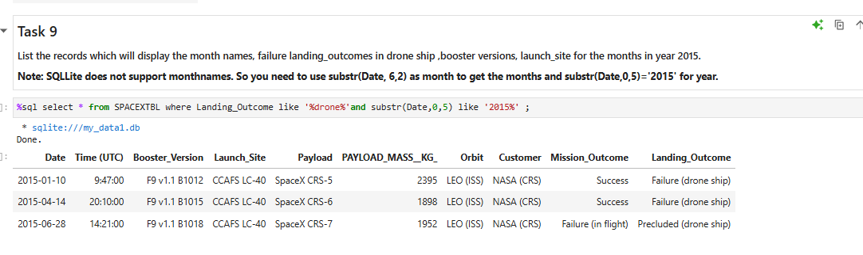
2015 Launch Records
We used query below

Slide 33
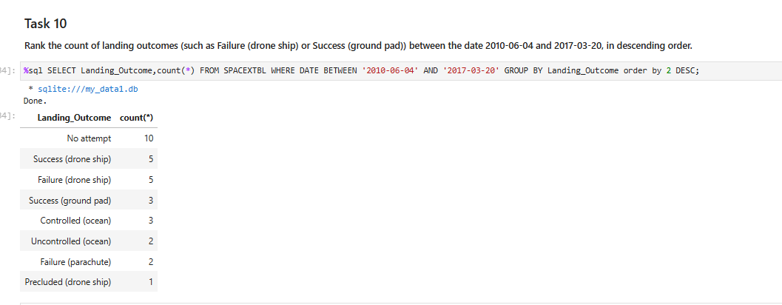
Rank Landing Outcomes Between 2010-06-04 and 2017-03-20
Rank the count of landing outcomes (such as Failure (drone ship) or Success (ground pad)) between the date 2010-06-04 and 2017-03-20, in descending order

Slide 34

Section 3

Slide 35
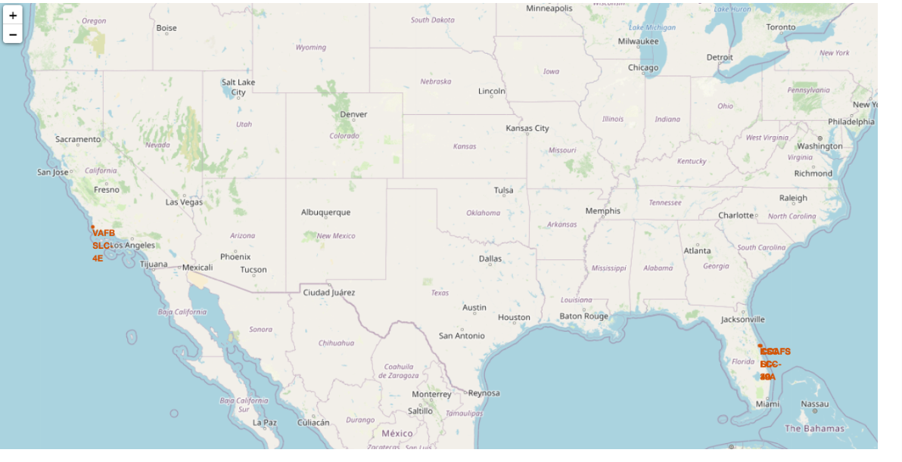
Launching sites map
SpaceX launch sites are located in US: Florida and California

Slide 36
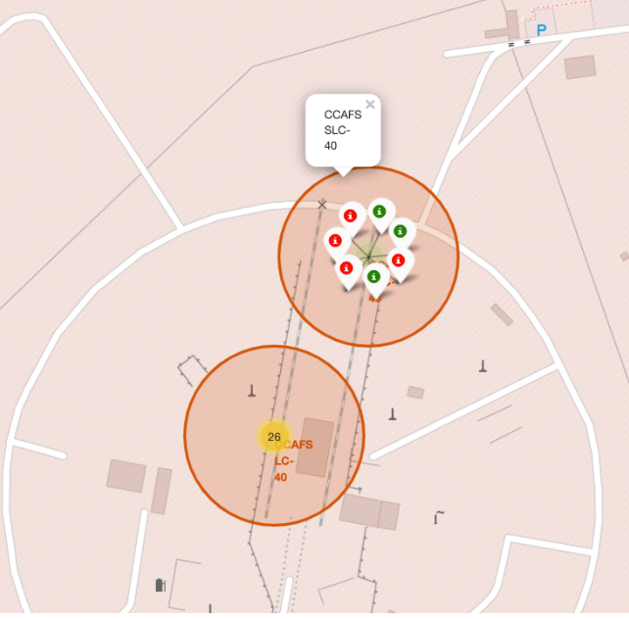
Markers on map
Green marker is successful launch and red is failure

Slide 37
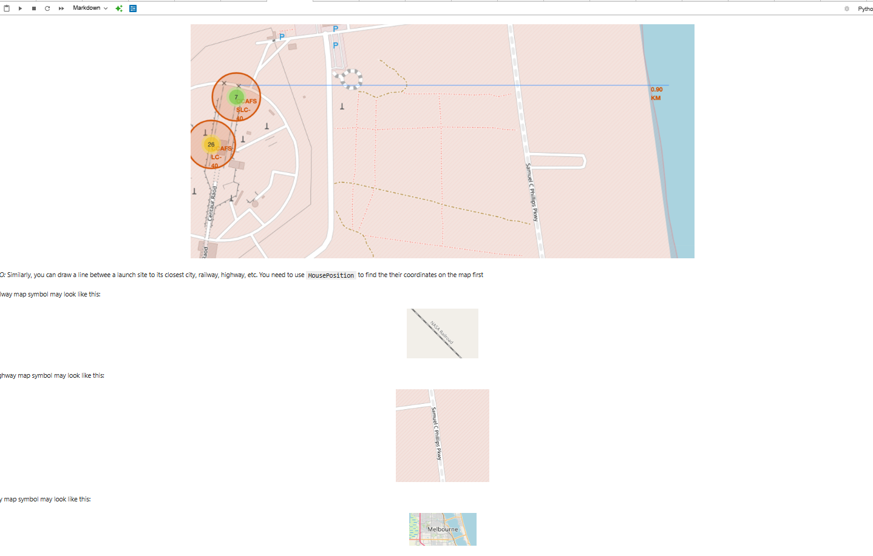
Distance from Launch site to specific landmarks

Slide 38

Section 4

Slide 39
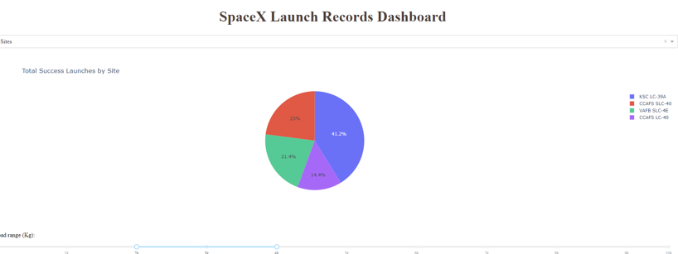
Total success Launches By All sites

Slide 40
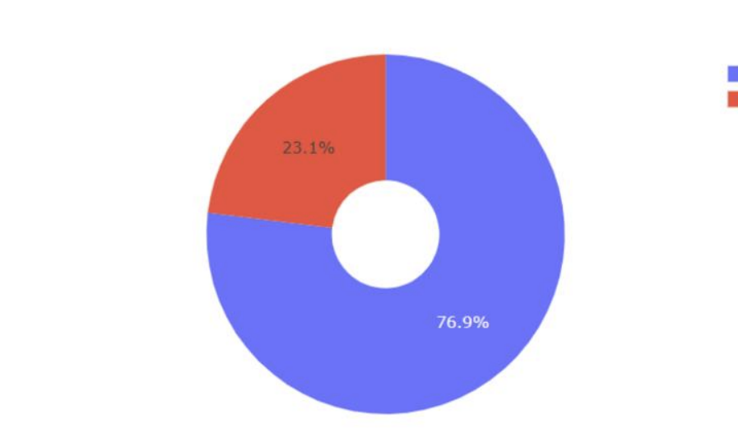
Site with highest rate success

Slide 41
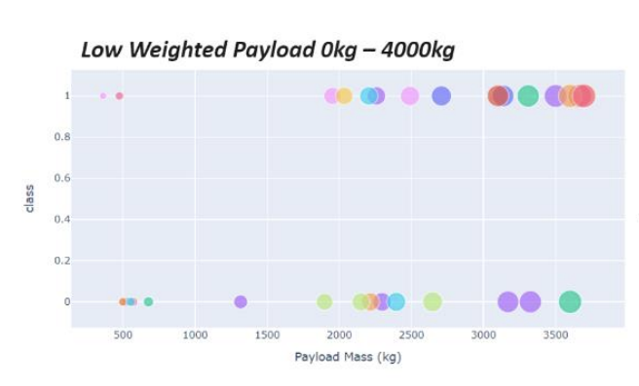
Payload vs Launch Outcome plot

Slide 42

Section 5

Slide 43
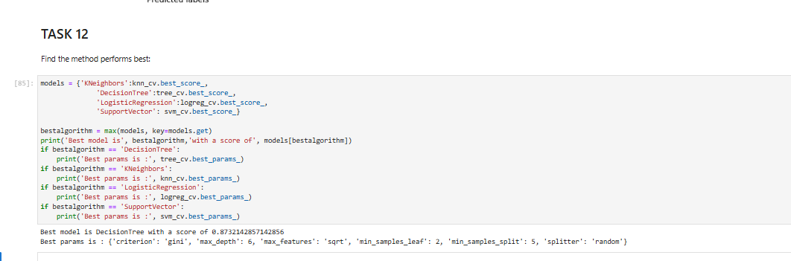
Classification Accuracy
As per below decision tree has the highest score and decision tree is the best model

Slide 44
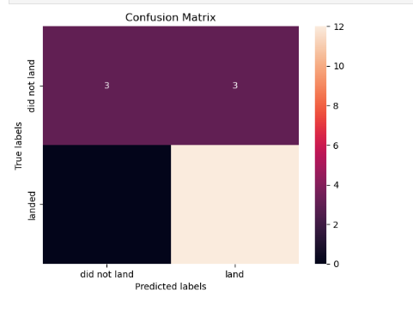
Confusion Matrix
It shows performance of classification model.As you can see below it shows the count of true(1) or false(0) predictions.

Slide 45
Conclusions
As per the analysis we perform we can state that:
Success rate increase from 2013 and is steady
The success rate depends on flight amount
KSC LC-39A is the most successful
Decision tree is the best ML model for this scenario

Slide 46
Appendix
Include any relevant assets like Python code snippets, SQL queries, charts, Notebook outputs, or data sets that you may have created during this project

Slide 47


